Slide 1

3666 ANLP
Predicting ECB Monetary Policy
Jonathan Fu
Fernando Espinosa
Shabnam Balamchi
Dec 16th/2023

Slide 2
Outline
Project Overview
Challenges and Complexities
Process Flow
Exploratory Data Analysis (EDA)
Methods and Models
Next steps

Slide 3


Project Overview: ECB Speech Analysis for Rate Change Prediction
Objective:
Predict ECB rate changes ("No Change," "Increase," or "Decrease") using speech text analysis.
Total speeches: 3,434
Date range: 1999–2023
Language: Majority in English
Key Question:
"How does speech content correlate with monetary policy decisions?“
Columns:
Speaker details (e.g., who, date, speech title).
Extracted text and term frequencies.
Monetary policy rate changes (% changes, direction).
Main Scope:
Data Analysis: Extraction and analysis of ECB speeches and press releases for predictive modeling.
Model Development: Building and fine-tuning a BERT-based vs LSTM classification model for forecasting ECB rate changes.

Slide 4
Challenges and Complexities
Class Imbalance
The "Decrease“ & “Increase” classes were significantly underrepresented, leading to poor performance.
Semantic Complexity
Speeches often contain complex language that makes it challenging for simpler models to capture nuances.
Overfitting Risks
Deep learning models like BERT and LSTM have a high capacity, increasing the risk of overfitting on a small dataset.
No Change 2,888 /Decrease 294 /Increase 252

Slide 5
Approaches Employed:
Handling Class Imbalance:
Class Weights: Adjusted loss function to give higher weight to underrepresented classes.
SMOTE: Oversampling for minority classes to balance the dataset during training.
Improving Feature Extraction:
BERT Fine-Tuning: Leveraged a pre-trained transformer model to extract semantic-rich features from text.
Keyphrase Extraction for LSTM: Focused on domain-specific keywords to simplify input features.
Mitigating Overfitting:
Early Stopping: Stopped training when validation loss did not improve after a set number of epochs.
Data Augmentation: Simulated additional training examples by paraphrasing existing data.

Slide 6
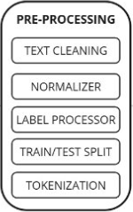


Process Flow
Title: Methodology Overview for ECB Rate Change Prediction
ECB Rate Changes Model
Data Collectionⁱ
Weblink Data
Speech Data ⁱⁱ
Rate Change Data ⁱⁱⁱ
No Change
Increase
Decrease
Fine-tuned BERT vs LASTM Model
ⁱ Screen-scraped ECB speeches and press releases using BeautifulSoup; tagged articles by dates between monetary policy decisions.
ⁱⁱ https://www.kaggle.com/datasets/robertolofaro/ecb-speeches-1997-to-20191122-frequencies-dm
ⁱⁱⁱ https://www.ecb.europa.eu/stats/policy_and_exchange_rates/key_ecb_interest_rates/html/index.en.html

Slide 7
Exploratory Analysis
Frequency Analysis: Understanding key terms and bigrams in the speeches.
Distribution Insights: Temporal and categorical patterns of the data.
Topic Modeling: Extracting dominant topics and their keywords using LDA.
Clustering Analysis: Visualizing clusters and validating using silhouette scores.

Slide 8
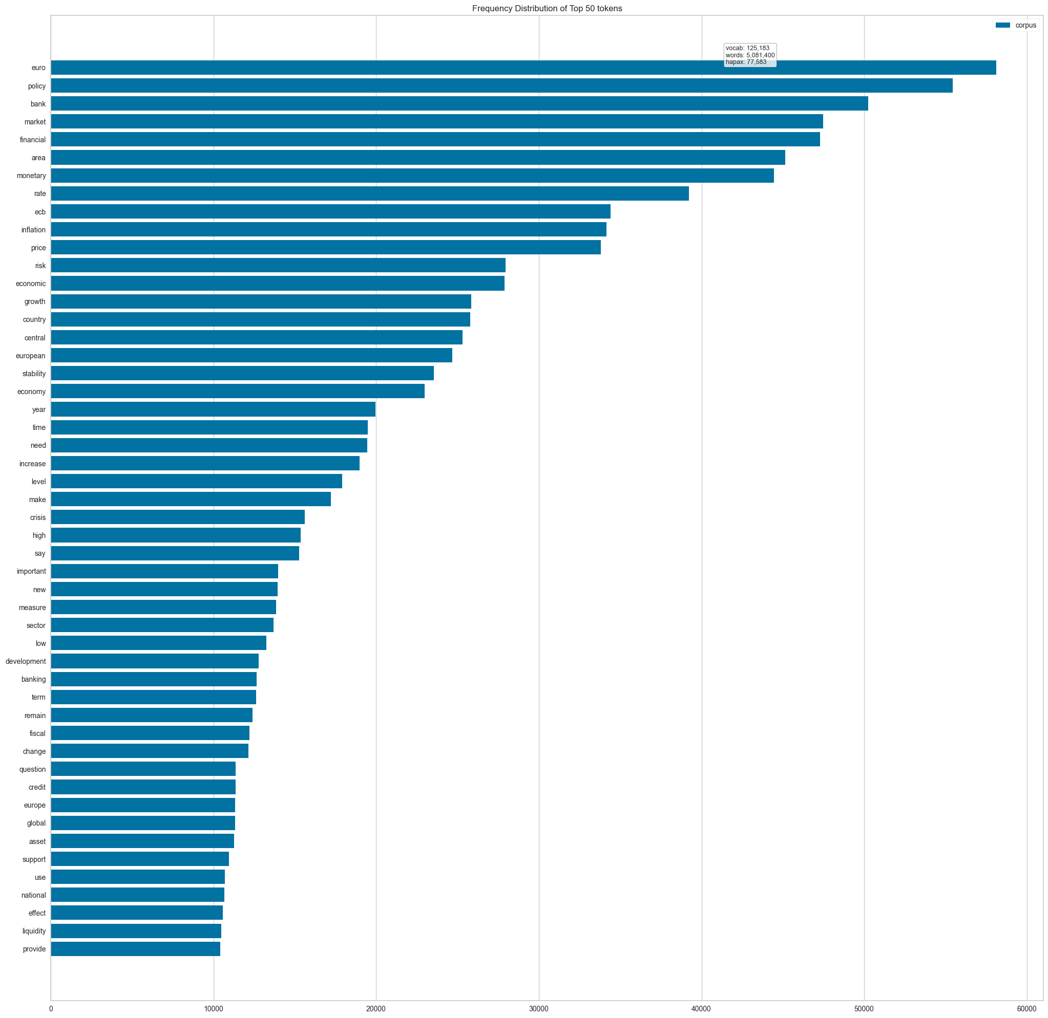
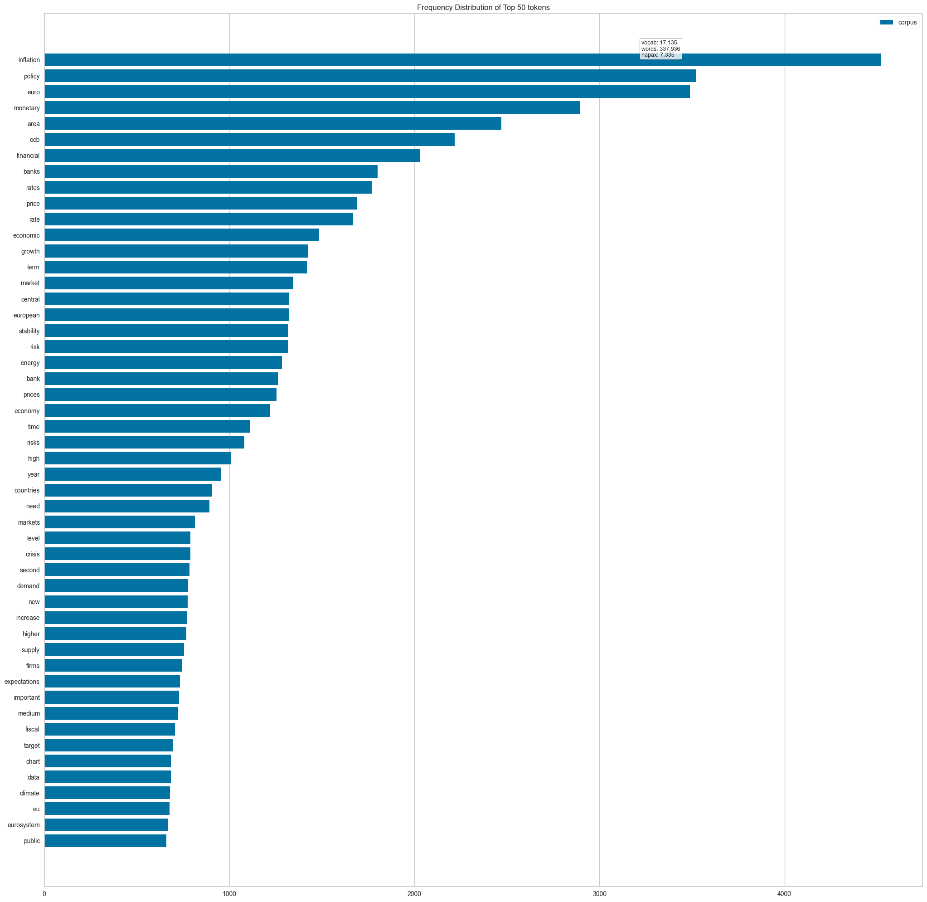
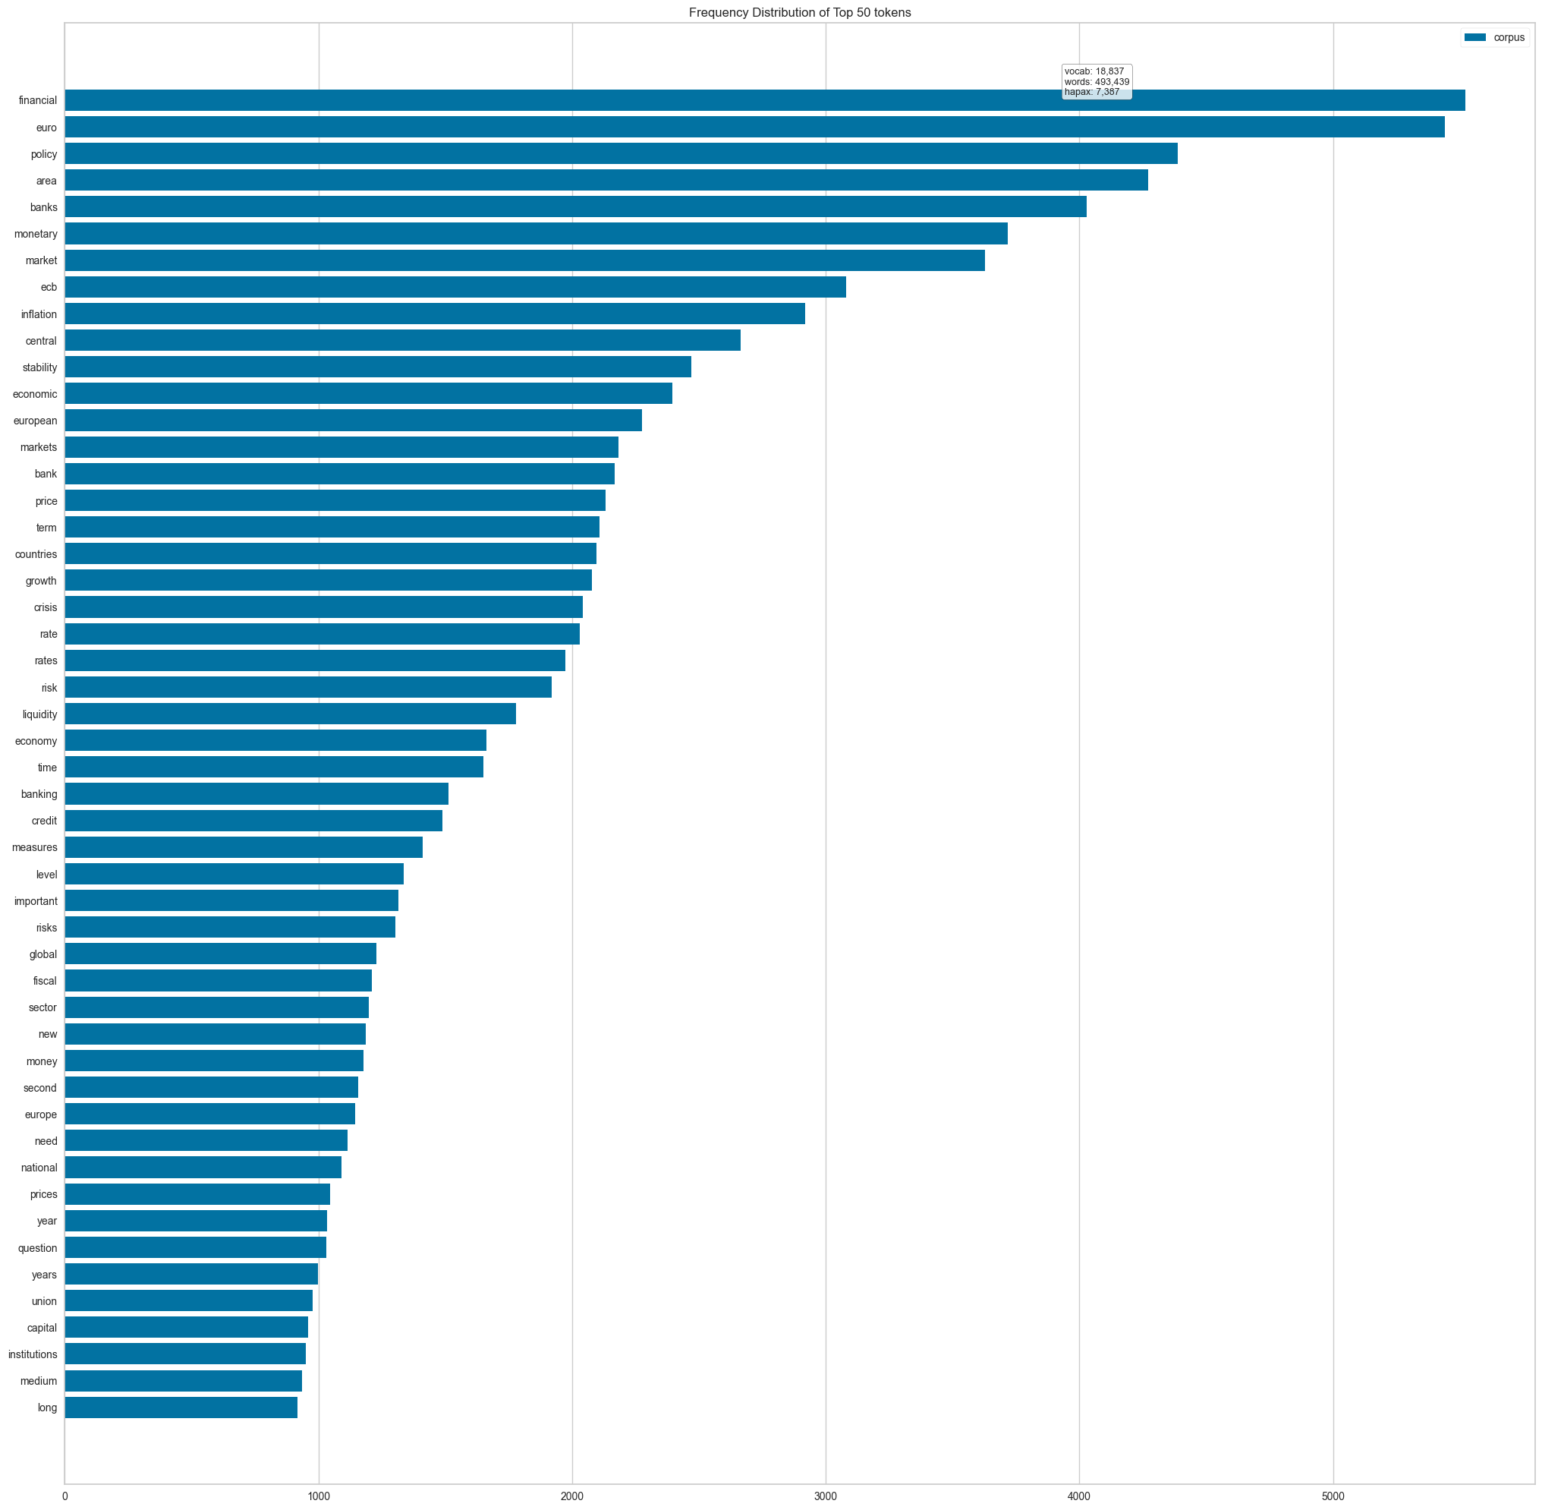
Frequency Distribution
Overall
Increase
Decrease

Slide 9
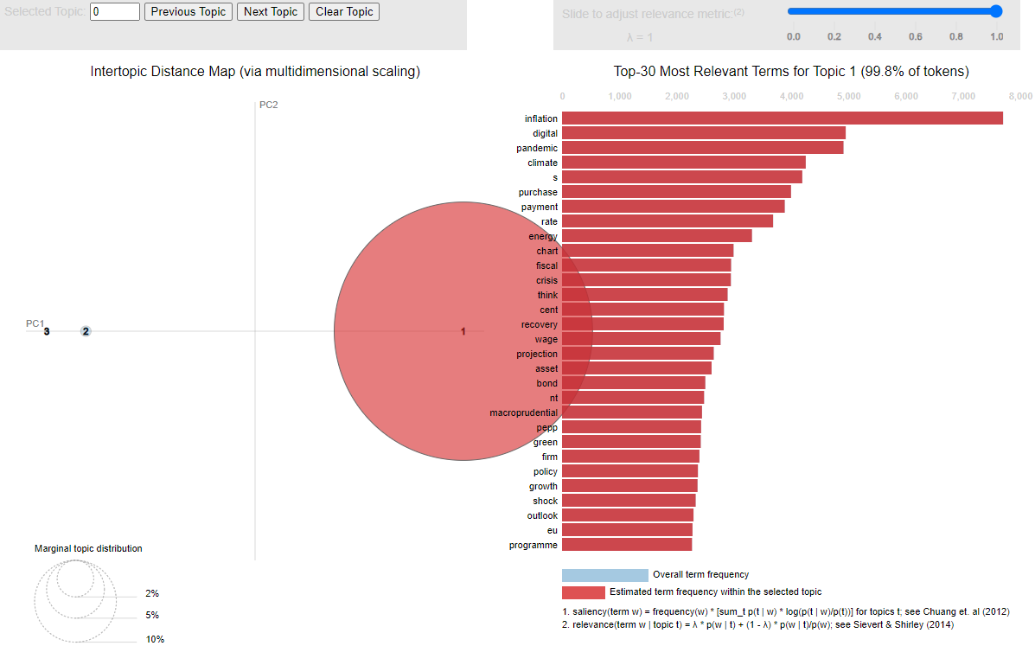
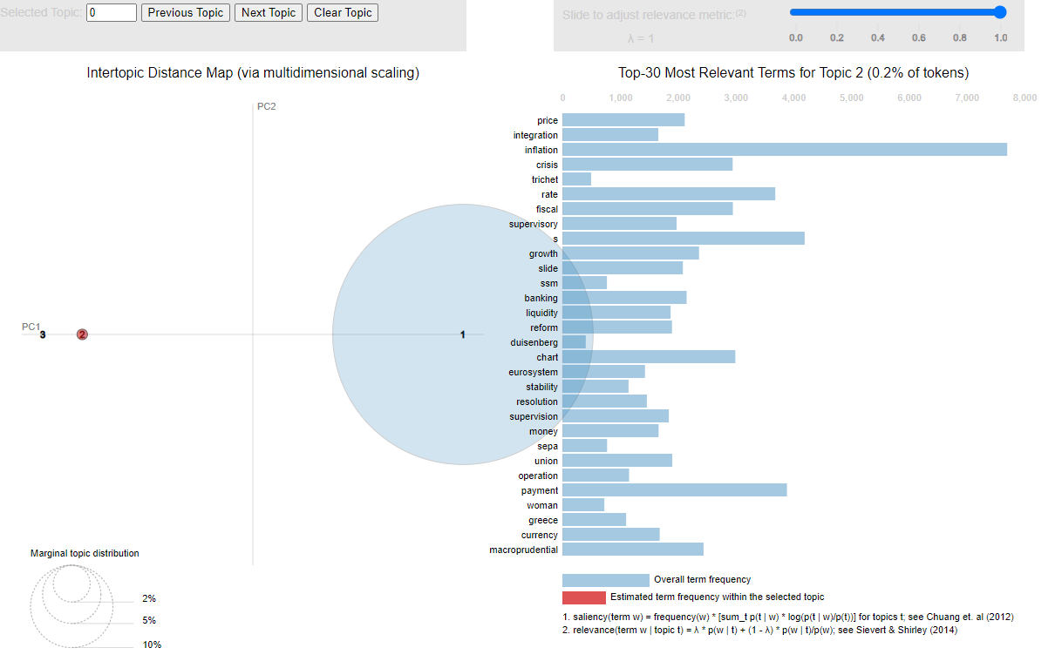
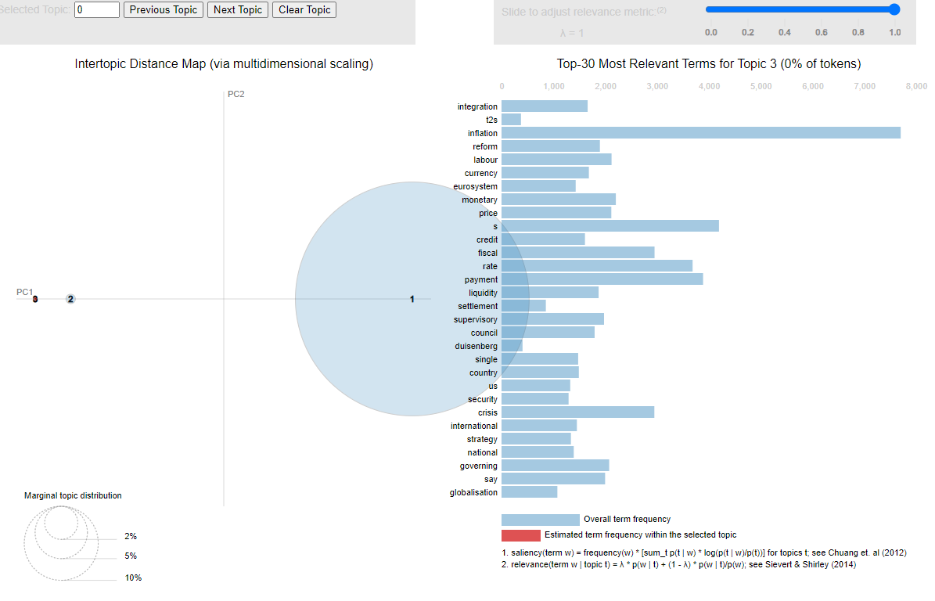
Key Topics in Speeches (Gensim LDA Visualization)
How ECB prioritizes its messaging in response to economic changes
Speeches cluster around 3–4 major themes:
Topic 1: Monetary policy, inflation, and price stability dominate discussions.
Topic 2: Digital euro and fiscal policy have emerged in recent years.
Topic 3: Broader economic growth and crisis-related topics.

Slide 10
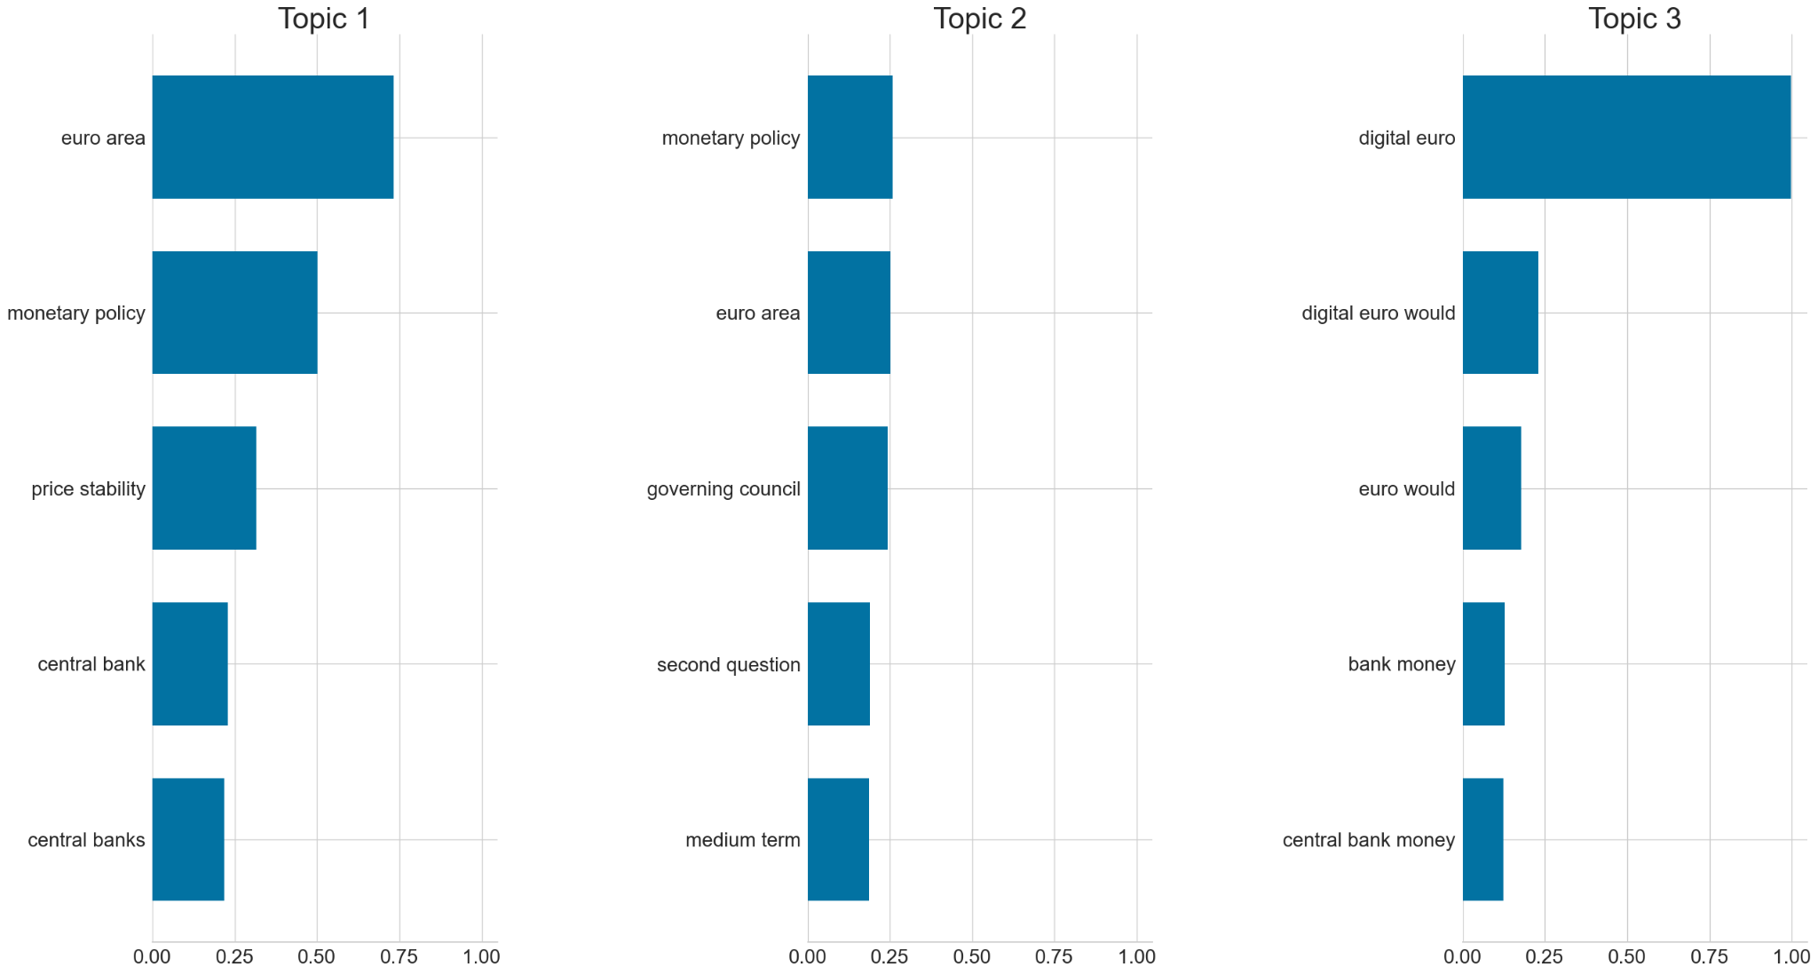
N-Grams
No significant difference between the overall topics vs. increase/decrease classes

Slide 11
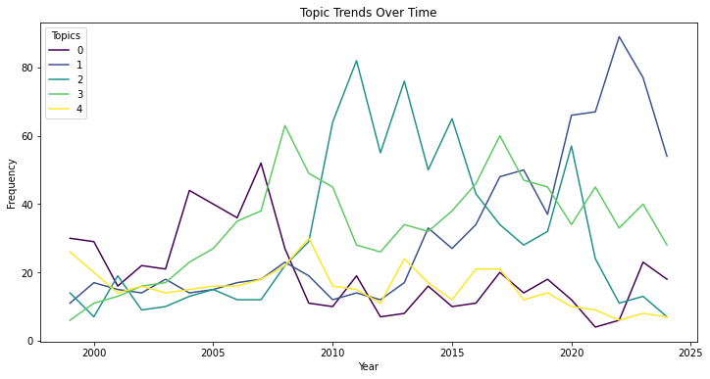
Temporal Trends in Topics
Digital euro and fiscal policy discussions have risen sharply since 2015.
Inflation and monetary policy remain consistently discussed across years.
This demonstrates how the ECB adapts its messaging to evolving economic conditions.
Topic 0 (financial growth and markets) saw a rise around 2010 but declined in prominence after 2015.
Topic 3 (economic and fiscal policy) peaked during the late 2000s, possibly reflecting responses to the 2008 financial crisis.
Topic 4 (central banking and risk management) had a steady focus, indicating its importance across different timeframes.

Slide 12
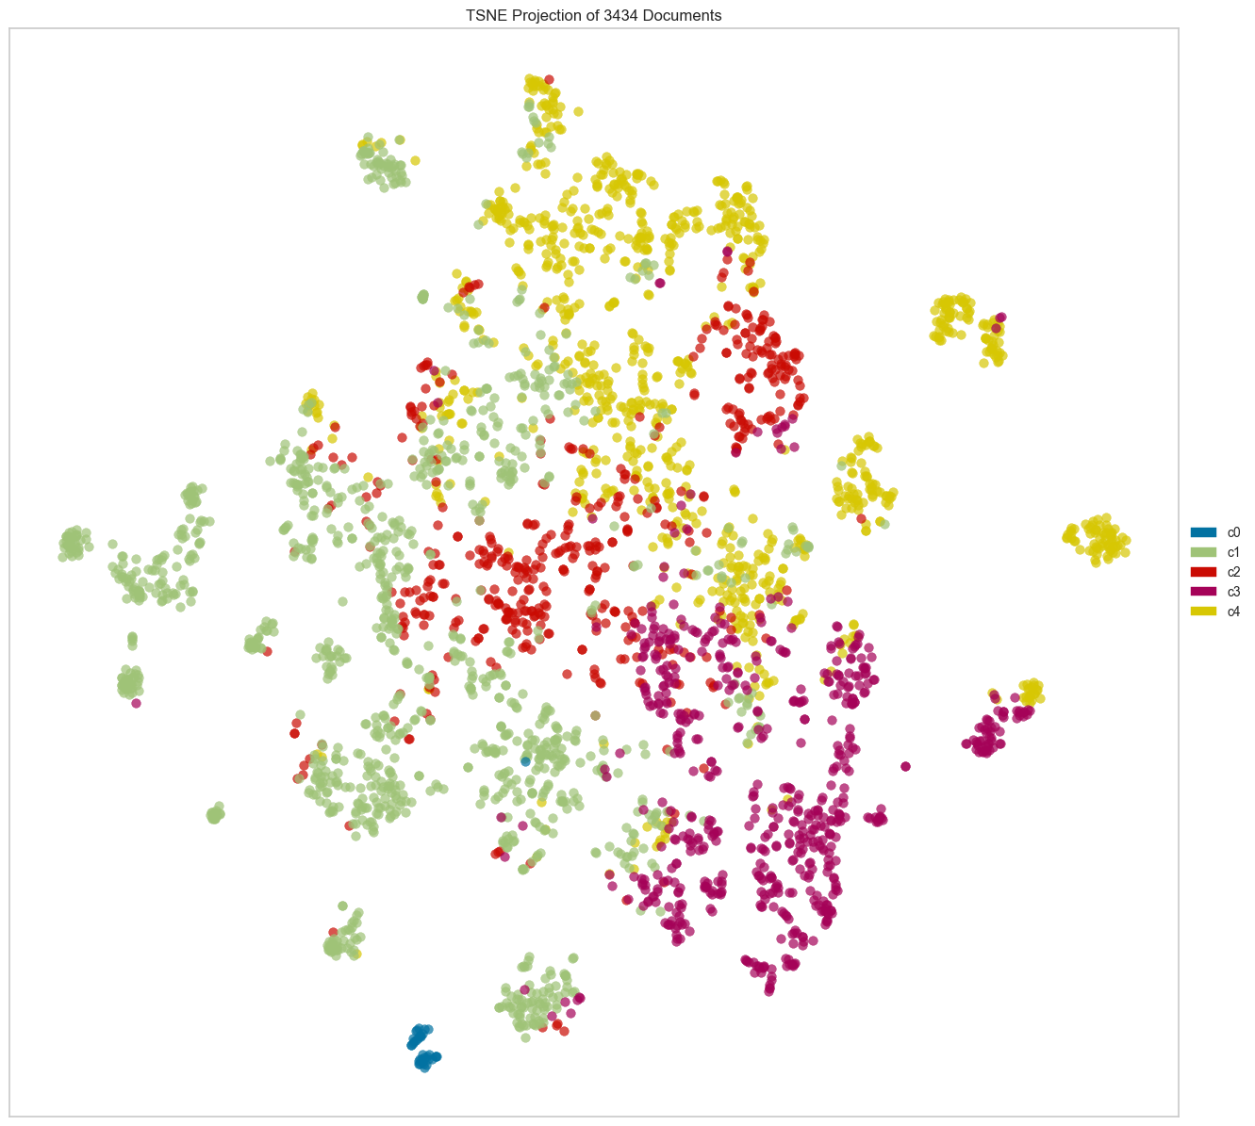
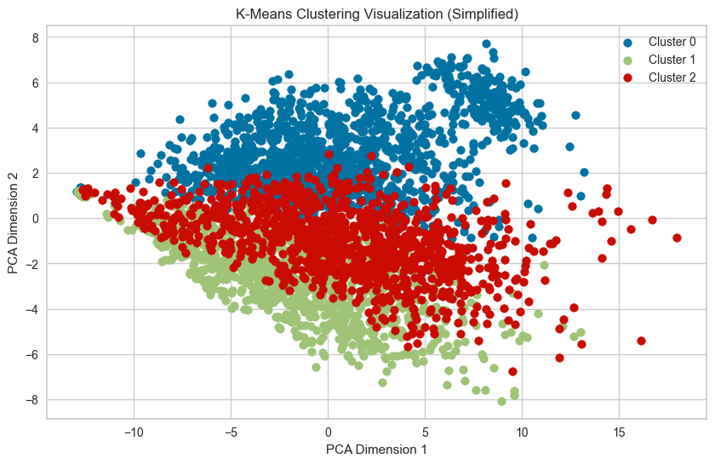
Unsupervised Cluster Analysis/t-SNE visualization
Best Clustering: The silhouette score is highest at k=2, indicating two dominant groupings or themes in ECB speeches.
Cohesion & Separation: k=2 provides the best balance between cohesion (within-cluster similarity) and separation (between-cluster distance).
Diminishing Returns: Lower scores for higher k suggest limited benefits from additional clusters, though finer nuances might still be captured.

Slide 13
Methods and Models
Metrics: Accuracy, AUPRC, F1-Score (Macro and Weighted), Confusion Matrix
Train/Eval split: 80/20 Test split: 20% held-out data to evaluate the final model.
BERT, LSTM, and Logistic Regression models
Classification Task: multiclass
Labels: No Change/Increase/Decrease
Model | Architecture | Size | Challenges Addressed
BERT | Transformer | Base | Semantic Complexity, Class Imbalance
LSTM | RNN | Base | Class Imbalance, Small Data Handling

Slide 14
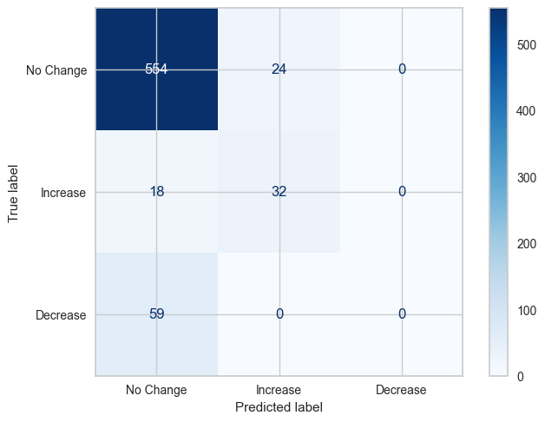
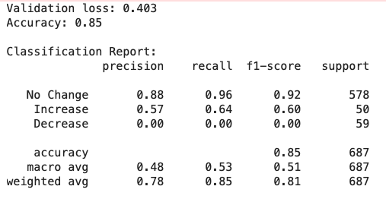
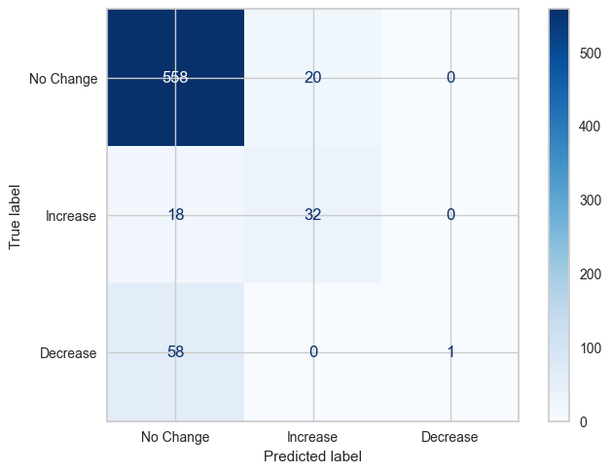
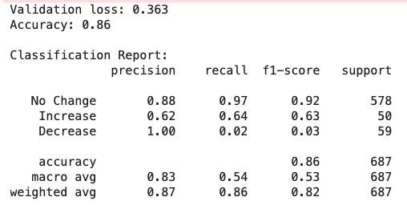
BERT
BERT - First 10 Epochs
BERT - 14 Additional Epochs

Slide 15
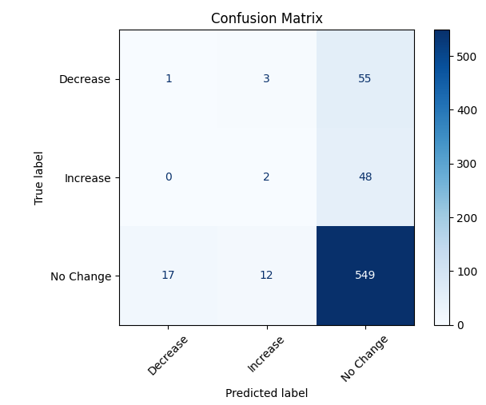
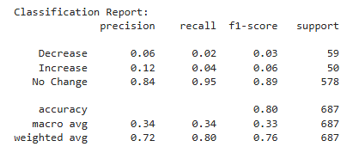
LSTM

Slide 16
Next Steps
Explore a multi-modal model:
Combine speech text with numerical/temporal data (e.g., historical rate changes, inflation rates) for more robust predictions.
Evaluate newer transformer models like FinBERT, RoBERTa or DeBERTa for better performance.
Test Sampling Techniques:
Use ADASYN or a combination of SMOTE + Cluster-Based Sampling for better oversampling.

Slide 17
Q&A

